Slide 1
Regular Expression

Slide 2
Regular expressions
The language accepted by DFA or NFA and ε-NFA is called regular language.
A regular language can be described using regular expressions consisting of the symbols such as alphabet in Σ, the operators such as ‘.’, ’+’ and ‘*’.
The three operators used to obtain a regular expression are:
+ :union operator (least precedence)
. : concatenation operator (next least precedence)
* : closure operator (highest precedence)

Slide 3
Regular expression
Definition: A regular expression is recursively defined as follows.
1.ϕ is a regular expression denoting an empty language.
2. ε-(epsilon) is a regular expression indicates the language containing an empty string.
3. a is a regular expression which indicates the language containing only {a}
4. If R is a regular expression denoting the language L_{R} and S is a regular expression denoting the language L_{S}, then
a. R+S is a regular expression corresponding to the language L_{R}UL_{S}.
b. R.S is a regular expression corresponding to the language L_{R}.L_{S}..
c. R* is a regular expression corresponding to the language L_{R}*.
5. The expressions obtained by applying any of the rules from 1-4 are regular expressions.

Slide 4
L={Ɛ,a,b,aa,ab,ba,bb,aaa,bbb,aba,abb,bba,}
L={abb, aabb,ababbababb, aaaaaabb,}
L={aa,aabab,bbbbaab, bababaabaabb,}
L={Ɛ,a,b,c,ab,ac,bc,aaaabc,bbbb,cccc,bc,}
L={a,bb,ababa,abbabbabb,}

Slide 5
The table shows examples of regular expressions and the language corresponding to these regular expressions.
Regular expressions | Meaning
(a+b)* | Set of strings of a’s and b’s of any length including the NULL string.
(a+b)*abb | Set of strings of a’s and b’s ending with the string abb
ab(a+b)* | Set of strings of a’s and b’s starting with the string ab.
(a+b)*aa(a+b)* | Set of strings of a’s and b’s having a sub string aa.
a*b*c* | Set of string consisting of any number of a’s(may be empty string also) followed by any number of b’s(may include empty string) followed by any number of c’s(may include empty string).
a⁺b⁺c⁺ | Set of string consisting of at least one ‘a’ followed by string consisting of at least one ‘b’ followed by string consisting of at least one ‘c’.
aa*bb*cc* | Set of string consisting of at least one ‘a’ followed by string consisting of at least one ‘b’ followed by string consisting of at least one ‘c’.

Slide 6
(a+b)* (a + bb) | Set of strings of a’s and b’s ending with either a or bb
(aa)*(bb)*b | Set of strings consisting of even number of a’s followed by odd number of b’s
(0+1)*000 | Set of strings of 0’s and 1’s ending with three consecutive zeros(or ending with 000)
(11)* | Set consisting of even number of 1’s

Slide 7
Problems
Obtain a regular expression representing strings of a’s and b’s
having length 2.
Length<=2.
Length<=10.
Even length.
Odd length.
Alternate a’s and b’s.
At most one pair of consecutive 0’s.
Containing at least one a and atleast one b where Σ={a,b}
At least three consecutive 0’s.
Ending with b and has no substring aa.
No two consecutive zero’s
Second symbol from the right end is a.
Third symbol from right is a and fourth symbol from the right is b.

Slide 8
Problem
Obtain a regular expression representing strings of a’s and b’s
Two or more letters but beginning and ending with the same letter where Σ={a,b}.
Length is either even or multiple of 3 or both.
Block of 4 consecutive symbols contains atleast two a’s
L={a^{n} b^{m} | m+n is even}
L={a^{n} b^{m} | m ≥ 1, n ≥ 1, nm ≥ 3}
L={a^{n} b^{m} | n ≥ 4, m ≤ 3}
L={a^{2n} b^{2m} | m ≥ 0, n ≥ 0}
Not containing more that three a’s.
L={w: n_{a}(w) mod 3 =0 | w Є (a,b)*}
Do not end with 01.
L = {vuv : u, v Є {a,b}* and |v|=2}
L={w: string ends with ab or ba where w Є (a,b)* }

Slide 9
Having length 2.
L={aa, ab, ba, bb}
R.E=(aa+ab+ba+bb)
=a(a+b)+b(a+b)
=(a+b)(a+b)
=(a+b)²
2. Length<=2.
L={Ɛ, a, b, aa, ab, ba, bb}
R.E = (Ɛ+a+b+aa+ab+ba+bb)
= (Ɛ+ a+b)(Ɛ+ a+b)
= (Ɛ+ a+b)²
Length<=10.
R.E= (Ɛ+ a+b)¹⁰
4. Even length.
L={Ɛ, aa, ab, ba, bb, abab, aabb, baab……}
R.E= (aa+ab+ba+bb)*
= ((a+b)(a+b))*
5. Odd length.
L={a,b,aaa, abb, ababa, aabbbaa……}
R.E= (aa+ab+ba+bb)*(a+b)
= ((a+b)(a+b))*(a+b)
OR
R.E= (a+b)(aa+ab+ba+bb)*
= (a+b)((a+b)(a+b))*

Slide 10
6. Alternate a’s and b’s.
L={Ɛ,a,b,ab,ba,aba,bab,abab,….}
R.E=(Ɛ+b)(ab)*(Ɛ+a)
7. At most one pair of consecutive 0’s.
i.e., any num. of 1’s with no 0’s or one ‘0’ or ‘00’
case 1: 1*
case 2: (1+01)* 0 (1+01)*
case 3: (1+01)* 00 (1+10)*
R.E= 1*+ (1+01)* 0 (1+01)*+ (1+01)* 00 (1+10)*

Slide 11
8. Containing at least one a and at least one b
L={ab, ba, aab, bab, bbbabbb,…..}
R.E=(a+b)*a (a+b)* b (a+b)*
R.E=(a+b)*(ab+ba)(a+b)*
At least three consecutive a’s.
L={aaa, baaab, aaaabb, bbaaaaa, baaab,…..}
R.E= (a+b)* aaa (a+b)*
Ending with b and has no substring aa.
L={b, bababab, abbbbab,bbabbab,……}
R.E=(b+ab)(b+ab)*
No two consecutive a’s
L={a,b, bababa, bbbbba,…….}
R.E=(b+ab)*(a+Ɛ)

Slide 12
12. Second symbol from the right end is a.
L={ab, aabbaa, aab, bab,……..}
R.E=(a+b)*a(a+b)
13. Third symbol from right is ‘a’ and fourth symbol from the right is ‘b’.
L={abaaa, bbabb,aaabaaa,…….}
R.E=(a+b)*ba(a+b)(a+b)
14. Two or more letters but beginning and ending with the same letter where Σ={a,b}.
L={abbbba, baaaab, abababa, bbbb, aaaa,……}
R.E=a(a+b)*a+b(a+b)*b

Slide 13
15. Length is either even or multiple of 3 or both.
L={Ɛ, ab,aa,abab,aba, abbabb, abbbabaaabbb,……}
R.E= ((a+b)(a+b))* + ((a+b) (a+b) (a+b))*
16. Block of 4 consecutive symbols contains atleast two a’s
L= {aabb, abab, abba, bbaa, baab, aaaa,……}
R.E=(aa(a+b)(a+b) + a(a+b)a(a+b) + a(a+b)(a+b)a + (a+b)(a+b)aa)⁺
L={a^{2n} b^{2m} | m ≥ 0, n ≥ 0}
L={Ɛ, aabb, aaaabbbb, aaaaaabbbbbb,…….}
R.E= (aa)*(bb)*

Slide 14
L={a^{n} b^{m} | m+n is even}
In the following two cases m+n becomes even
Case 1: even num a’s followed by even num of b’s R.E=(aa)*(bb)*
Case 2: odd num a’s followed by odd num of b’s R.E=a(aa)*b(bb)*
R.E==(aa)*(bb)* + a(aa)*b(bb)*
19. L={a^{n} b^{m} | n ≥ 4, m ≤ 3}
a^{n} where n ≥ 4 means atleast 4 a’s R.E= aaaa(a)*
b^{m} where m ≤ 3 means atmost 3 b’s R.E= (Ɛ+b+bb+bbb)
R.E= aaaa(a)* (Ɛ+b+bb+bbb)

Slide 15
L={a^{n} b^{m} | m ≥ 1, n ≥ 1, nm ≥ 3}
nm≥ 3, if m=1 then n ≥ 3 R.E= aaa(a)*b
nm≥ 3, if n=1 then m ≥ 3 R.E= abbb(b)*
nm≥ 3, if n ≥ 2then m ≥ 2 R.E= aa(a)*bb(b)*
R.E= aaa(a)*b + abbb(b)* + aa(a)*bb(b)*
21. Not containing more that three a’s.
R.E= b* (Ɛ+a) b* (Ɛ+a) b* (Ɛ+a) b*
22. L={w: n_{a}(w) mod 3 =0 | w Є (a,b)*}
R.E= (aaa)* --- multiples of 3
R.E= (b* a b* a b* a b* )*

Slide 16
23. Do not end with ab.
R.E= (a+b)*(aa+ab+bb)
24. L = {vuv : u, v Є {a,b}* and |v|=2}
R.E= aa(a+b)*aa + ab(a+b)*ab + ba(a+b)*ba + bb(a+b)*bb
25. L={w: string ends with ab or ba where w Є (a,b)* }
R.E= (a+b)*(ab+ba)
26. Odd number of b’s
R.E= a* b a* (ba*ba*)*
27. The language of C identifiers
C identifiers are letters(l)- a+b+c+…..+z+A+B+……+Z
digits(d)- 0+1+2+……….+9
underscore(_)- _ and always start with l or _
R.E= (l+_)(l+d+_)*

Slide 17
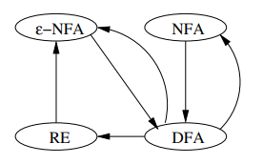
Finite Automata and Regular Expression

Slide 18
Converting R.E to Automata
Theorem:
Every language defined by a regular expression is also defined by a Finite Automata.
OR
Let R be a regular expression. Then there exists a finite automaton M=(Q, ∑, δ, q₀, F) which accepts L(R).
OR
Prove that there exists a finite automaton to accept the language L(R) corresponding to the regular expression R.

Slide 19



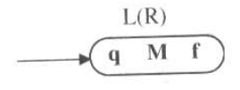
Proof:
Basic: By definition, ϕ, ε and a are regular expression.
The schematic representation of a regular expression R to accept the language L(R) is shown in below figure, where q is the start state and f is the final state of a machine M.
Figure: Ɛ-NFA to accept ϕ, ε and a
Figure: schematic representation of FA accepting L(R)

Slide 20
Induction:
By the definition, if R₁ and R₂ are regular expression, the R₁ + R₂ , R₁ . R₂ , R* are regular expression.
Let M₁=(Q₁, ∑₁, δ₁, q₁, f₁) be a machine which accepts the language L(R₁) corresponding to the regular expression R₁
Let M₂=(Q₂, ∑₂, δ₂, q₂, f₂) be a machine which accepts the language L(R₂) corresponding to the regular expression R₂

Slide 21
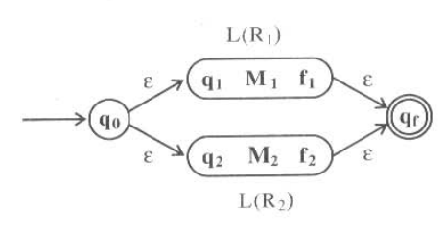
Case 1:
R= R₁ + R₂
Construct automaton which accepts the language L(R₁) or L(R₂) which can be represented as L(R₁ + R₂) as shown in figure
Figure: To accept the language L(R₁ + R₂)

Slide 22
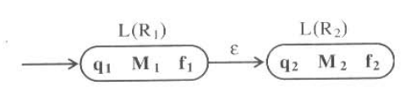
Case 2:
R=R₁ . R₂
Construct automaton which accepts the language L(R₁) followed by L(R₂) which can be represented as L(R₁ . R₂) as shown in figure
Figure: To accept the language L(R₁ . R₂)

Slide 23
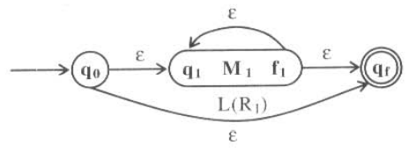
Case 3:
R=(R₁)*
Construct automaton which accepts the language L((R₁)*) as shown in figure
Figure: To accept the language L((R₁)*)

Slide 24

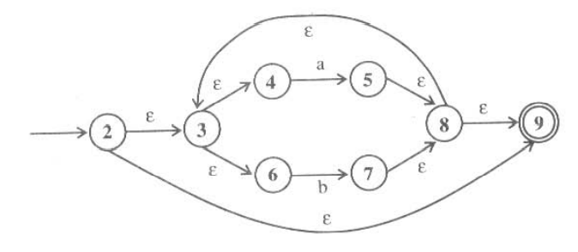
Problems
Obtain an NFA which accepts strings of a’s and b’s starting with ab
R.E=ab(a+b)*
Starting with ab
(a+b)*

Slide 25
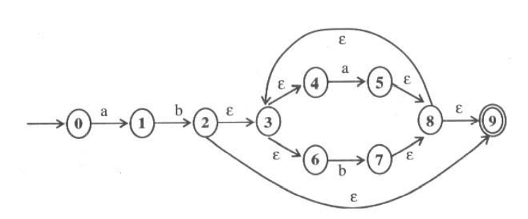
Figure: To accept language ab(a+b)*

Slide 26
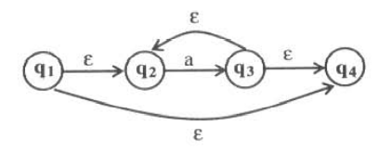
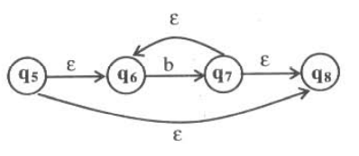
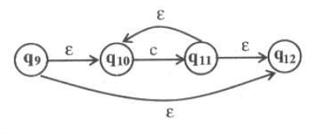
Problems
Obtain an NFA which accepts strings of a’s and b’s having
R.E=a*+b*+c*

Slide 27
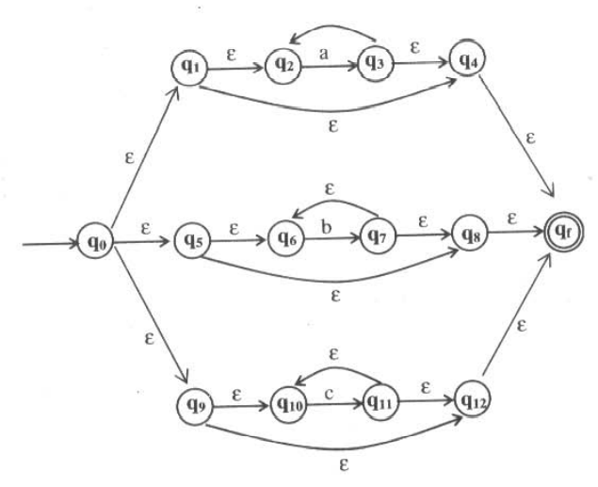
Figure: To accept R.E=a*+b*+c*

Slide 28
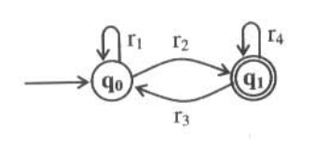
Converting Finite Automata to R.E (State elimination method)
R.E= r1*r2 (r4 + r3 r1*r2)*

Slide 29
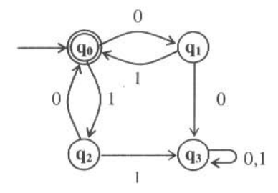
Obtain the R.E for the finite automata given below using state elimination method.

Slide 30
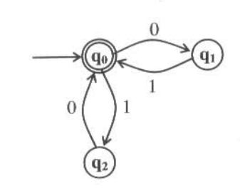
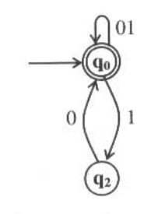
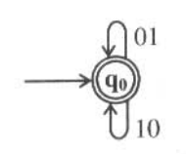
R.E=(01+10)*

Slide 31
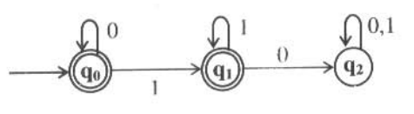
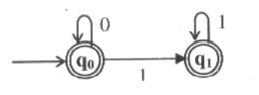
Obtain the R.E for the finite automata given below using state elimination method.
R.E=0*+ 0*11*
=0*(Ɛ+11*)
=0*(Ɛ+1*)
=0*1*

Slide 32
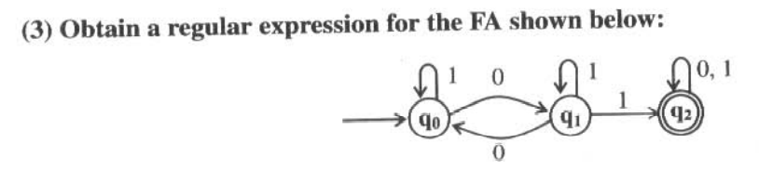

Slide 33
Properties of regular language
1. Closure properties of regular languages
Used to build recognizers for languages that are constructed from other languages by certain operations.
Ex. Automata for intersection of two regular languages
2. Decision properties of regular languages
– Used to find whether two automata define the same language
– Used to minimize the states of DFA
-Eg. Design of switching circuits.

Slide 34
closure properties of regular languages
1. The union of two regular languages is regular.
2. The intersection of two regular languages is regular.
3. The complement of a regular language is regular.
4. The difference of two regular languages is regular.
5. The reversal of a regular language is regular.
6. The closure (star) of a regular language is regular.
7. The concatenation of regular languages is regular.
8. A homomorphism (substitution of strings for symbols) of a regular language is regular.
9. The inverse homomorphism of a regular language is regular

Slide 35
Closure of regular languages under Boolean operations
Ex1.
L1={a,a³,a⁵,-----}
L2={a²,a⁴,a⁶,-----}
L1 ᴜ L2 = {a,a²,a³,a⁴,----}
RE=a(a)*
Ex2.
L1={ ab,a² b², a³b³, a⁴b⁴,-----}
L2={ab,a³ b³,a⁵b⁵,-----}
L1 ᴜ L2 = {ab,a²b², a³b³, a⁴b⁴, a⁵b⁵----}
RE=ab(ab)*

Slide 36
Closure of regular languages under Boolean operations
Closure Under Complementation
Theorem : If L is a regular language over alphabet S, then L = Σ* - L is also a regular language.
Proof: - Let L =L(A) for some DFA. A=(Q, Σ, δ, q₀, F).
Then L = L(B), where B is the DFA (Q, Σ, δ, q₀, Q-F).
That is, B is exactly like A, but the accepting states of A have become non-accepting states of B, and vice versa, then w is in L(B) if and only if δ*( q₀, w) is in Q-F, which occurs if and only if w is not in L(A).
Ex1. L1={a,a3,a5,-----}
Σ* -L1={e,a2,a4,a6,-----}
RE=(aa)*

Slide 37
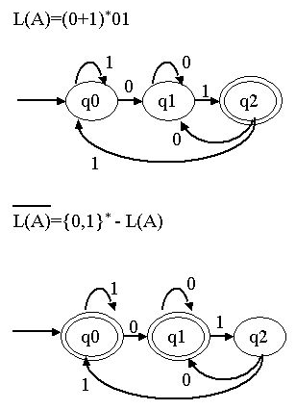
Ex2. Consider a DFA, A that accepts all and only the strings of 0’s and 1’s that end in 01. i.e L(A) = (0+1)*01. The complement of L(A) is therefore all string of 0’s and 1’s that do not end in 01

Slide 38
Closure Under Intersection
Theorem : If L and M are regular languages, then so is L ∩ M.
Proof :Let L and M be the language of automata A_{L} =(Q_{L}, Σ, δ_{L}, q_{L}, F_{L}) and A_{M} =(Q_{M}, Σ, δ_{M}, q_{M} , F_{M}).
Assume the alphabets of both automata are the same; i.e., Σ is the union of the alphabets of L and M. A_{L} and A_{M} are DFA’s.
For L ∩ M, we shall construct an automata A that simulate both A_{L} and A_{M} . Formally, we define
A =(Q_{L} x Q_{M}, Σ, δ, (q_{L} , q_{M} ) , F_{L} xF_{M} )
where δ ((p,q),a)=(δ_{L} (p,a), δ_{M}(q,a)).
“w” string is accepted by A if and only if both A_{L} and A_{M} accept w.
i.e δ_{L}*(q_{L},w) ϵ F_{L} and δ_{M}*(q_{M},w) ϵ F_{M}
Thus , A accepts the intersection of L and M.

Slide 39
Closure of regular languages under Boolean operations
Ex1.
L1={a,a²,a³,a⁴,a⁵,a⁶,-----}
L2={a²,a⁴,a⁶,-----}
L1∩L2 = {a²,a⁴,a⁶,----}
RE=aa(aa)*
Ex2
L1={ab,a³b³,a⁵b⁵,a⁷b⁷-----}
L2={a² b², a⁴b⁴, a⁶b⁶,-----}
L1∩L2 = ϕ
RE= ϕ

Slide 40

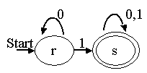
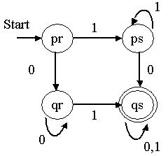
Closure of regular languages under Boolean operations
Ex3.
Consider a DFA that accepts all those strings that have a 0.
Consider a DFA that accepts all those strings that have a 1.
The product of above two automata is given below.

Slide 41
Closure of regular languages under Boolean operations
The Ex3 says:
This automaton accepts the intersection of the first two languages:
Those languages that have both a 0 and a 1.
Then pr represents only the initial condition, in which we have seen neither 0 nor 1.
Then state qr means that we have seen only once 0’s, while state ps represents the condition that we have seen only 1’s.
The accepting state qs represents the condition where we have seen both 0’s and 1’s.

Slide 42
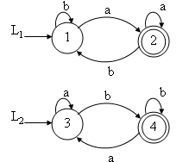
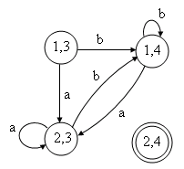
Ex 4
Write a DFA to accept the intersection of L1=(a+b)*a and L2=(a+b)*b that is for L1∩L2.
DFA for L1 ∩ L2 = ϕ (as no string has reached to final state (2,4))

Slide 43
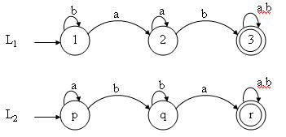
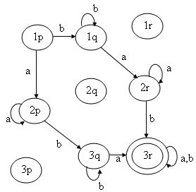
Ex5
Find the DFA to accept the intersection of L1=(a+b)*ab (a+b)* and L2=(a+b)*ba (a+b)* that is for L1 ∩ L2

Slide 44
Closure Under Difference
Theorem : If L and M are regular languages, then so is L – M.
Proof : observe that L-M= L∩M. by theorem closure under complement , M is regular, and by theorem closure under intersection L∩M is regular. Therefore L-M is regular.
Ex.
L1={a,a³,a⁵,a⁷,-----}
L2={a^{2,}a⁴,a⁶,-----}
L1-L2 = {a,a³,a⁵,a⁷----}
RE=a(a)*

Slide 45
Closure under Reversal
Closure under Reversal
Definition :
Reversal of a string:
The reversal of a string a₁a₂a₃…..a_{n} is the string written backward, i.e., a_{n}a_{n-1}……a₃a₂a₁. Denoted by w^{R}.
Ex: 0010^{R} is 0100 and ε^{R} is ε.
Reversal of a language:
It is a language consisting of the reversals of all its strings. Denoted by L^{R}
Ex.
L={001,10,111,01}
L^{R}={100,01,111,10}

Slide 46
Closure under Reversal
Theorem : If L is a regular language, then L^{R} is regular.
Proof based on automata:
As L is regular it can be defined by an FA, M = (Q, Σ , δ, q0, F), having only one final state.
If there are more than one final states, we can use ε- transitions from the final states going to a common final state.
Let FA, M^{R} = (Q^{R}, Σ ^{R} , δ ^{R},q₀^{R},F^{R}) defines the language L^{R}, Where Q^{R} = Q, Σ ^{R} = Σ, q₀^{R}=F,F^{R}=q₀, and δ ^{R} (p,a)-> q, iff δ(q,a) -> p.
Since M^{R} is derivable from M, L^{R} is also regular.

Slide 47
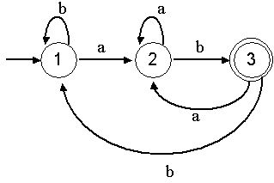
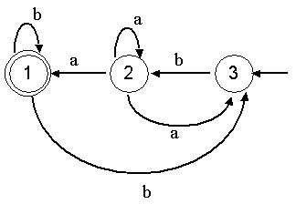
Closure under Reversal
The proof implies the following method
1. Reverse all the transitions.
2. Swap initial and final states.
3. Create a new start state p₀ with transition on ε to all the accepting states of original DFA.
Example:Let r=(a+b)* ab define a language L.
That is L = {ab, aab, bab,aaab, -----}. The FA is as given below
The FA for L^{R} can be derived from FA for L by swapping initial and final states and changing the direction of each edge. It is shown in the above right figure.

Slide 48
Closure under Reversal
Proof based on regular expression:
Let L is the language corresponding to regular expression E.
It is required to P.T there is another regular expression E^{R} such that L(E^{R})=(L(E))^{R} .
Which is read as “language of E^{R} is the reversal of language of E”.
Basis: By definition of R.E, we have ϕ, ε and a are R.E.
So, the reversal of regular expression E^{R} is given by:
{ε}^{R}={ε}
{ϕ}^{R} = ϕ
{a}^{R}={a}

Slide 49
Closure under Reversal
Induction: Again, by definition of R.E, if E1 and E2 are regular expressions, then: E1+E2 , E1.E2 and E1* regular expressions.
Case 1: E=E1+E2 is a R.E, then
E^{R}=E1^{R}+E2^{R}
Is a R.E denoting the languages:
L(E^{R})=L(E1^{R}) ᴜ L(E2^{R})
Case 2: E=E1.E2 is a R.E, then
E^{R}=E1^{R}.E2^{R}
Is a R.E denoting the languages:
L(E^{R})=L(E1^{R}).L(E2^{R})
Case 3: E=E1* is a R.E, then
E^{R}=E1^{R}
Is a R.E denoting the languages:
L(E^{R})=L(E1^{R})

Slide 50
Closure under Homomorphism
Homomorphism:
Definition : A string homomorphism is a function on strings that works by substituting a particular string for each symbol.
OR
Definition: Let Σ and Г are set of alphabets. The homomorphic function
h: Σ → Г*
is called Homomorphism i.e., a substitute where a single letter is replaced by a string. If w=a₁a₂a₃…..a_{n}, then h(w)=h(a₁)h(a₂)…….h(a_{n}).
If L is made of alphabets from Σ, then h(L)={ h(w) | w ϵ L} is called homomorphic image.

Slide 51
Closure under Homomorphism
Example 1: Let Σ={0,1} , Г ={0,1,2} and h(0)=01, h(1)=112. what is h(010)? If L={00,010}. What is homomorphic image of L?
Soln: By definition, h(w)=h(a₁)h(a₂)…….h(a_{n}).
So,
h(010)=h(0)h(1)h(0)
h(010)=0111201
L(00,010)=L ( h(00),h(010) )
=L( h(0)h(0), h(0)h(1)h(0) )
L(00,010)=L( 0101 , 0111201 )

Slide 52
Closure under Homomorphism
Example 2: Let Σ={0,1} , Г ={1,2,3} and h(0)=3122, h(1)=132. what is (0+1)*(00)*?
Soln: By definition, h(w)=h(a₁)h(a₂)…….h(a_{n}).
So,
(0+1)*(00)*=(h(0)+h(1))* (h(0)h(0))*
(0+1)*(00)*=(3122+132)* (31223122)*

Slide 53
Closure under Homomorphism
Theorem : If L is a regular language over alphabet Σ, and h is a homomorphism on Σ, then homomorphic image h (L) is also regular.
Proof : Let R be the regular expression and L(R) be the corresponding regular language.
We can easily find h(R) by substituting h(a) for each a in Σ .
By definition of regular expression , h(R) is a regular expression and so h(L) is regular language.
So, the regular language is closed under homomorphism.

Slide 54
Closure under Homomorphism
Inverse Homomorphism
Theorem : If h is a homomorphism from alphabet S to alphabet T, and L is a regular language over T, then h⁻¹ (L) is also a regular language.
Ex. Let L be the language of regular expression (00+1)*.
Let h be the homomorphism defined by h(a)=01 and h(b)=10. Then h⁻¹(L) is the language of regular expression (ba)*.

Slide 55
Decision properties of regular languages
1. Is the language described empty?
2. Is a particular string w in the described language?
3. Do two descriptions of a language actually describe the same language?
This question is often called “equivalence” of languages.

Slide 56
Converting Among Representations
Consider the time complexity of each of the conversions.
Converting NFA’s to DFA’s
Time taken for either an NFA or ε-NFA to DFA can be exponential in the number of states of the NFA.
Computing ε -Closure of n states takes O(n³) time.
Computation of DFA takes O(n³) time where number of states of DFA can be 2^{n}.
The running time of NFA to DFA conversion including ε transition is O(n³ 2^{n}).
Therefore, the bound on the running time is O(n³s) where s is the number of states the DFA has.
DFA to NFA Conversion
Conversion takes O(n) time for an n state DFA.

Slide 57
Converting Among Representations
Automaton to Regular Expression Conversion
For DFA where n is the number of states,
Conversion takes O(n³4^{n}) by substitution method and
by state elimination method conversion takes O(n³) time.
If we convert an NFA to DFA and then convert the DFA to a regular expression it takes the time O(n³ 4^{n3} 2^{n}).
Regular Expression to Automaton Conversion
Regular expression to ε-NFA takes linear time – O(n) on a regular expression of length n.
Conversion from ε -NFA to NFA takes O(n³) time.

Slide 58
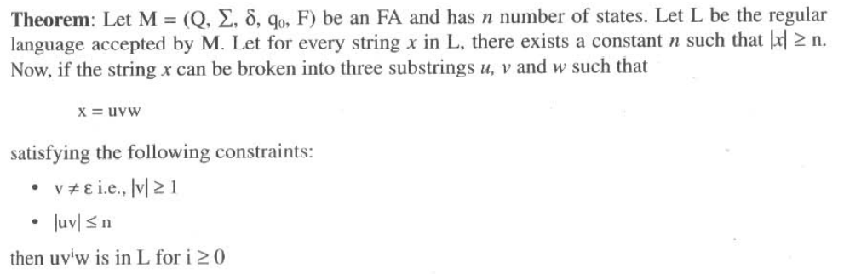
Pumping Lemma for Regular Languages

Slide 59
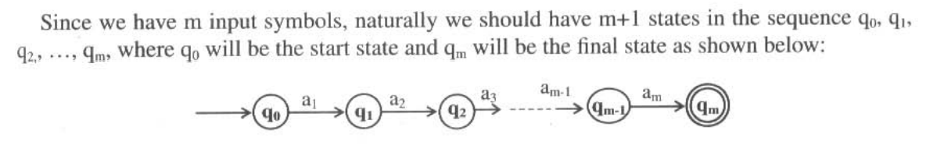

Slide 60
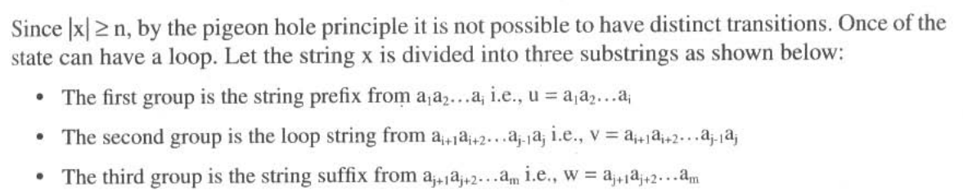
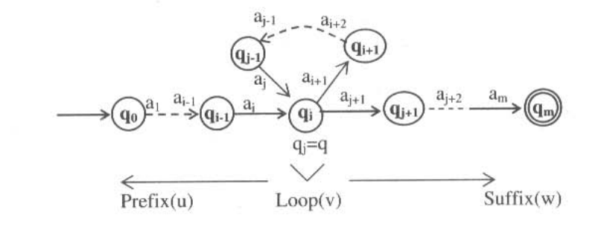

Slide 61
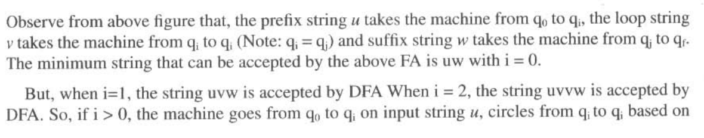
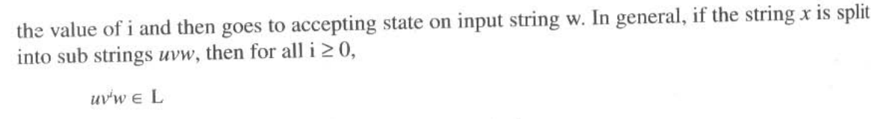

Slide 62
Applications of Pumping Lemma
Pumping lemma is used to prove that certain languages are non-regular. But it cannot be used to prove that a given language is regular.
Using pumping lemma, it is possible to check whether a language accepted by FA is finite or infinite.

Slide 63
The general strategy used to prove that certain language is not regular is shown below.
Step 1: Assume that the language L is regular, and ‘n’ be the number of states of FA.
Step 2: Select the string x such that lx| ≥ n and break it into substrings u, v and w so that x = uvw with the constraints:
v ≠ Ɛ i.e., |v| ≥1
|uv|≤n
Step 3: Find any i such that uv^{i}w is not in L i.e., uv^{i}w ∉ L.
According to the pumping lemma, uv^{i}w is in L for i ≥ 0. So, the result is a contradiction to the assumption that the language is regular.
Therefore, the given language L is not regular.

Slide 64
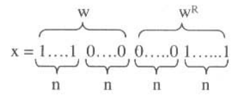
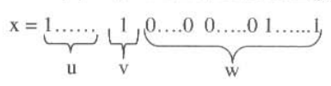
Show that L = (ww^{R} |w ∈ (0+1)*) is not regular.
Step 1:
Let L is regular and n be the number of states in FA. Consider the string:
where n is the number of states of FA,
w = 1....10....0 and reverse of w is given by w^{R}=0…..01…..1 .

Slide 65
Step 2: Since Ixl≥ n, we can split the string x into uvw such that |uv|≤n
and |v| ≥1 as shown below:
where |u| = n-1 and lv| = 1 so that |uv| = |u| + |v| = n-1+1 = n which is true. According to the pumping lemma, uv^{i}w ∈ L for i = 0, 1, 2,...
Step 3: According to the pumping lemma, uv^{i}w ∈ L for i = 0, 1, 2,...
If i is 0, i.e., v does not appear and so the number of 1's on the left of x will be less than the number of 1's on the right of x and so the string is not of the form ww^{R}.
So, uv^{i}w ∉ L. when i = 0.
This is a contradiction to the assumption that the language is regular. So, the language L = ( ww^{R} I w e (0+11*) is not regular.

Slide 66
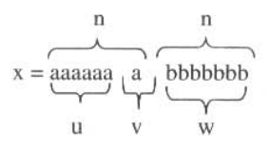
Show that L = {a^{n}b^{n} |n≥1) is not regular.
Step 1:
Let L is regular and n be the number of states in FA. Consider the string: x =aaaabbbb.
Since Ixl=2n≥n, we can split the string x into uvw such that |uv|≤n and |v| ≥1 as shown below:
where |u| = n-1 and lv| = 1 so that |uv| = |u| + |v| = n-1+1 = n which is true.

Slide 67
Step 3: According to the pumping lemma, uv^{i}w ∈ L for i = 0, 1, 2,...
If i is 0, i.e., v does not appear and so the number of a’s will be less than the number of b's and so the string is not of the form ‘n’ number a’s followed by ‘n’ number of b’s
So, uv^{i}w ∉ L. when i = 0.
This is a contradiction to the assumption that the language is regular.
So, the language L = {a^{n}b^{n} |n≥1) is not regular.

Slide 68
Show that L = {a^{i}b^{j} |i>j) is not regular.
Step 1:
Let L is regular and n be the number of states in FA. Consider the string: x =a^{n+1}b^{n}.
Since Ixl=2n+1≥n, we can split the string x into uvw such that |uv|≤n and |v| ≥1 as shown below:
x= a^{n+1}b^{n} = a^{m} a^{k} ab^{n}
u v w
where |u| = m and lv| = k>1 so that |uv| = |u| + |v| = m+k ≤ n which is true. According to the pumping lemma, uv^{i}w ∈ L for i = 0, 1, 2,...

Slide 69
Step 3: According to the pumping lemma, uv^{i}w ∈ L for i = 0, 1, 2,...
i.e., a^{m} ( a^{k})^{i} ab^{n} ∈ L for i ≥0
If i is 0, i.e., number of a’s in string u will not be more than the number of b’s in w.
So, uv^{i}w ∉ L. when i = 0.
This is a contradiction to the assumption that the language is regular.
So, the language L = {a^{i}b^{j} |i>j) is not regular.

Slide 70
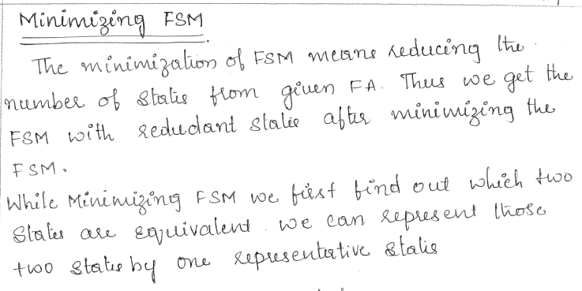

Slide 71
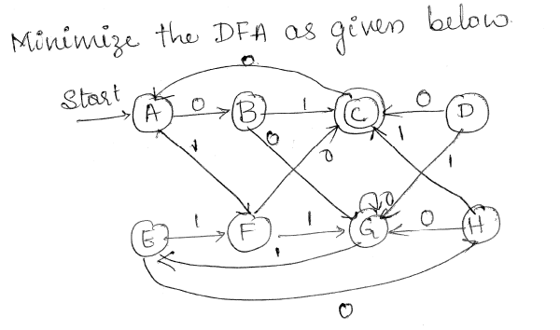
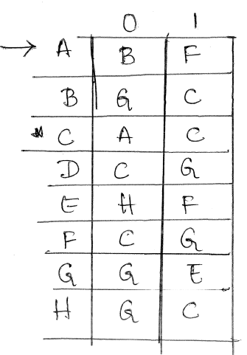

Slide 72
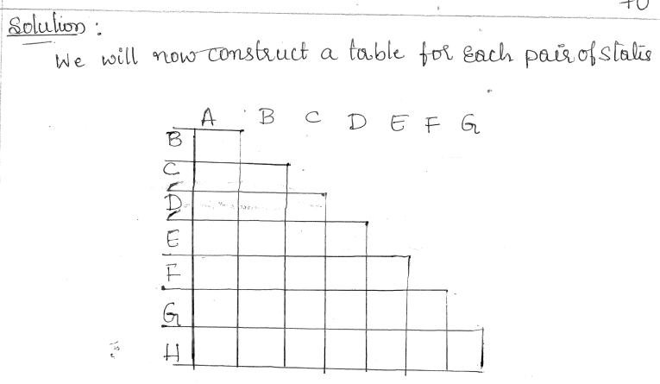

Slide 73
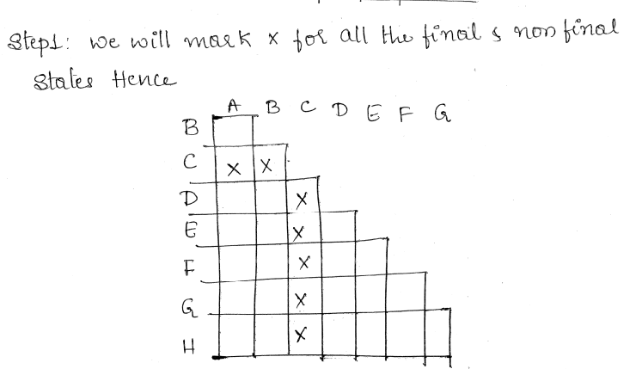

Slide 74
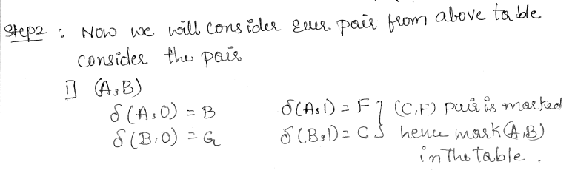

Slide 75
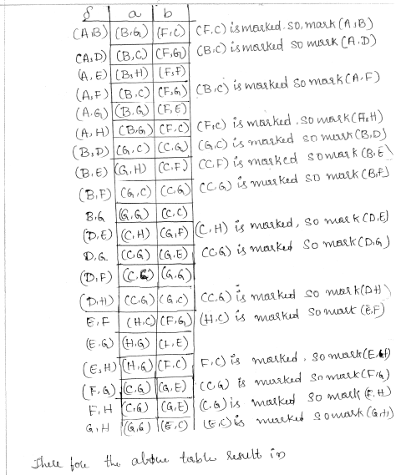
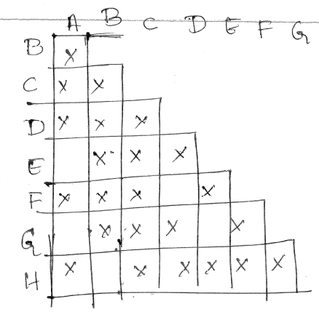

Slide 76
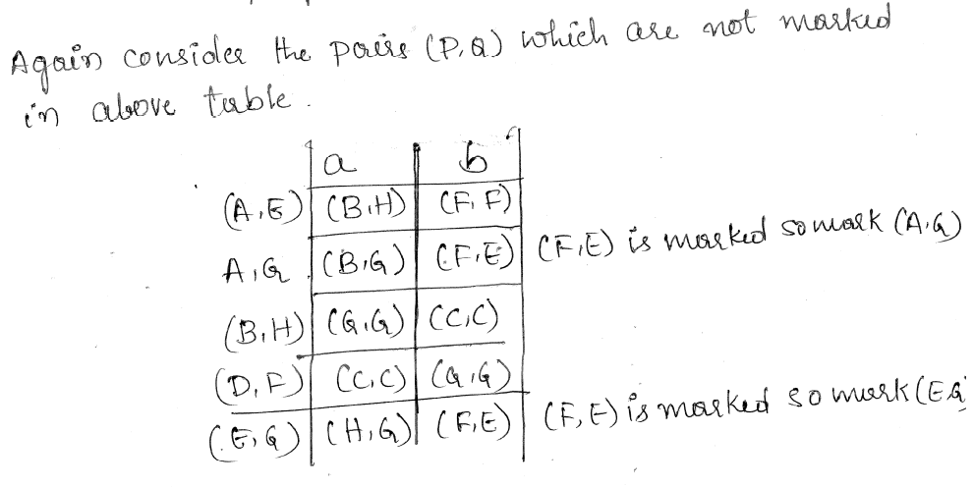
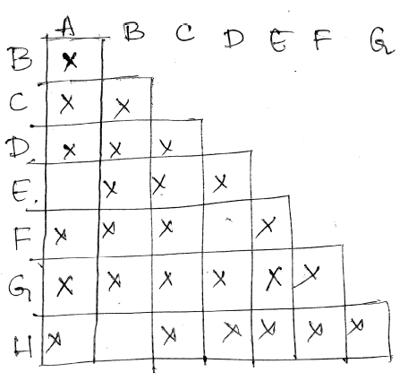

Slide 77
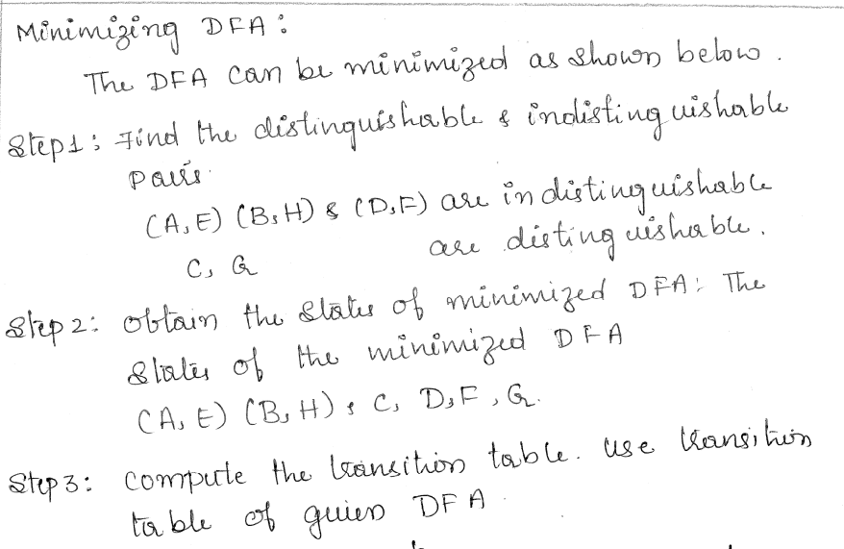

Slide 78
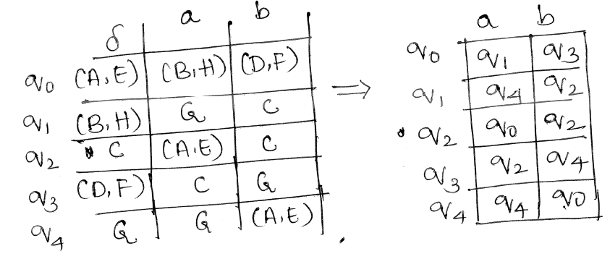
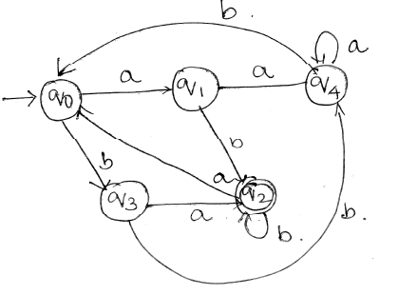

Slide 79




Slide 80




Slide 81



Slide 82


Slide 83


Slide 84



Slide 85



Slide 86


Slide 87


